Slide 1
Towards a New Tunisian Reality International Policy Debate Conference Tunis, June 17, 2011
The Potential Future Reality of Tunisia’s Political Landscape:
Dialectics in Turkey :
Kemalist Jacobinism and the Islamist party
Baskın Oran
baskinoran@gmail.com, www.baskinoran.com

Slide 2
Terminology:
Kemalism: A modernist movement of the 1920s and 30s, the main philosophy of which is to adopt the «Contemporary Civilization». Its partisans, mainly represented by CHP today, still uphold a Jacobinist Nation-state. (The nascent liberal movement in CHP is not taken into consideration in this presentation)
Nation-state: A type of State which wants its nation to be an ethnic and religious monoblock, and uses assimilation and/or ethno-religious cleansing to achieve this aim
Revolution From Above: This is a short-cut. A top-down reform movement of Westernized petty-bourgeois elites who aim at making deep-reaching changes in society by changing the superstructure (the laws) of the country. In other words, they trigger «lazy» internal dynamics and «reboot» the system
Islamist party: Is based on the idea that the source of sovereignty is not Nation, but God
Laic, laicism, laicist: a State policy that dominates religion to create a secular medium
Secular: An attribute of the Nation, meaning that the source of sovereignty is temporal, instead of spiritual (God)
Identity
Infra identity: One’s ethnic/religious group identity
Supra identity: Identity imposed by the State upon the individual in a view to achieve cohesion

Slide 3
Laicism and Secularism
Laic, Laicism, Laicist
Secular, Secularism, Secularist
From “laicus”
From “saeculum” (contemporary)
French impact, hard policy because feudalism has not been under control for long.
Catholic States
Anglo-Saxon impact, soft policy because feudalism is already under control.
Protestant States
An attribute of “State”
(State policy to create a secular environment)
An attribute of “nation”
(Source of sovereignty not spiritual but temporal)

Slide 4
Hypotheses stemming from the Turkish experience since the abolition of the caliphate in 1924
«Revolution from above»: Rebooting is a one-shot gun. Otherwise, it’s bound to be harmful to the user:
It perturbs the very internal dynamics which it aims to regulate,
It degenerates into a status-quo policy which aims to perpetuate privileges of the bureaucracy, the Military in particular,
It strengthens it’s own antagonist(s) and creates a vicious circle. In this case, the worst move is a Military Coup
Islamist Party:
Once it firmly enters a democratic political system in a GLOBALIZED world, the «Islamic party» has to change so as to abide with the rules of the System. Coming to power might «tame» it further
On the other hand, for a variety of reasons, it must be very closely checked and balanced by Civil Society
Laicism:
Can function better in a multi-religious/confessional society where one single religion/confession does not dominate all others. (non-Muslims & Alevis)
In case the State does not evolve from Domination of the religion to Neutrality vis-a-vis all beliefs, laicist policy can become a quasi-religion itself.

Slide 5
Kemalism, The FIRST wave of modernization: a huge leap forward in development
Ottoman Empire
Kemalist revolution (1920s & 30s)
Semi - feudal Empire
Nation -state
Sultan’s Subject
Citizen
Umma
Nation

Slide 6
THE KEMALIST REVOLUTION - A realistic APPRAISAL
Kemalism, very successful in emulating the European civilization of its time (1930s), is now a stumbling block on the road to the Second Wave of Modernization aiming at the present European civilization (EU)
«Contemporary civilization» of the 1930s was totally monist & authoritarian, if not totalitarian. Building «Turkish nation» naturally followed the same model and what it created was a monist Nation composed of «compulsory» citizens:
Suppressing minorities, both non-Muslim and Muslim, denying ethnic/religious infra-identities vis-a-vis the religio-ethnic supra identity, Turkishness,
Suppressing any opposition, especially the Left,
Suppressing Islam in a way to interfere with private lives
Now, Europe of 2000s is a perfect antithesis of the Europe of 1930s. «Democracy» no more means the rule of the majority, but the recognition of infra identities.
Kemalists today still adhere to 1930 principles focused on strong Nation-state. They think that a society focused on the Individual will split the country
Furthermore, they refuse to admit the principle of one-shot gun. This is best illustrated by the story of Military Coups, especially by that of 1980.

Slide 7
1980 military coup and its dialectical consequences:
Main results of the Coup:
Tortures by the Military make life unbearable, especially for the Kurds
“Green/Islamist/Anatolian Capital” (“Anatolian Tigers”) rises.
Impact of the “Turco-Islamic Synthesis”, the official ideology of the military coup anxious to fill in the ideological vacuum left by Socialism
But especially: Impact of the “gold coins under the pillow” that turned into investments thanks to Prime Minister Özal’s bank credits (1983 →)
Final outcome: The advent of Kemalism’s antitheses:
Eruption of an armed Kurdish nationalism (1984)
Eruption of an Islamist party representing Anatolian Capital: 1995 election victory of RP.

Slide 8
IslamIst party (rp) and the jacobine answer: the Military memorandum of 28 Feb. 1997
As a coalition government partner, RP acts like a spoiled child who obtained everything at once
Prime Minister Erbakan: “Now the question is whether Islam will come smoothly or by bloodshed” (1994)
T. Erdoğan, RP Mayor of Istanbul: “They say sovereignty belongs to the Nation. Just watch this big lie!” (1994)
Another mayor of RP: “Muslims should not forget the greed, grudge and hate inside them” (1996)
MÜSİAD, the main representative of the Green Capital, engages into open confrontation with TÜSİAD, the representative of the Grand Bourgeoisie of Istanbul. This is an in-class class struggle
RP is for interest-free Islamic banking, pro-Iran, and is against foreign capital, EU, and Israel
The National Security Council, dominated by the Military, reacts by publishing a memorandum on 28 February 1997 defending laicism. This has the support of:
The mainstream media which was very carefully manipulated by the Military,
The Grand Bourgeoisie who is no more afraid of Communism but is afraid of Islamists,
The bulk of the nascent civil society which is against the Islamists
RP fell and was closed by Court, but the memorandum was again going to create its antagonist when 2002 elections came. Claimant for power this time is a very different type of “Islamist” because in a very short time the Green Capital went through a very interesting transformation.

Slide 9
metamorphosis of the green capital: from rp to akp
In less than two decades Green Capital has literally metamorphosed:
In late 80s Green Capital, in contradistinction with the Istanbul (Grand) Capital who made its accumulation by closing the customs until early 80s («import substitution»), starts to export. It thus opens to international market and articulates to Globalization/international capitalism.
The superstructure follows suit. In the 90s comes the “Green» pop, hard rock, metal groups. Islamist stand-up stars make fun, among others, of those who leave their mobile phone open during the prayer. Islamist women go jogging. The veil now means a visa to go out on the street and meet your boyfriend, and smoke a cigarette
MUSIAD’s governing board goes to the cocktail party given in honor of the 50th anniversary of the Israeli State. They drink lemonade only, but one of them says: “Our grudge against Israel is over”.
In the 2000s, many Islamist companies are gone bankrupt, Hizbullah is despised as their “torture houses” are discovered. The new key concept is EU
AKP «imports» legitimacy,
EU values profit the Islamists most (freedom of expression, of belief, etc.)
Islamists are now the New Rich. M. Jourdains are in search of interior designers

Slide 10
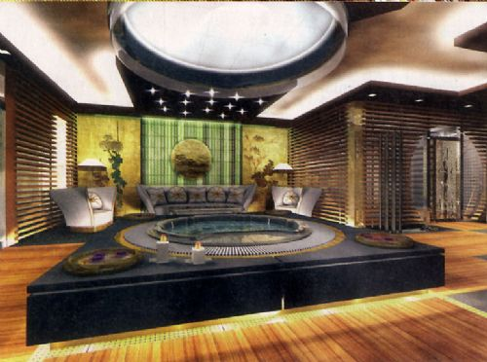
Living room of a rich muslim house, istanbul

Slide 11
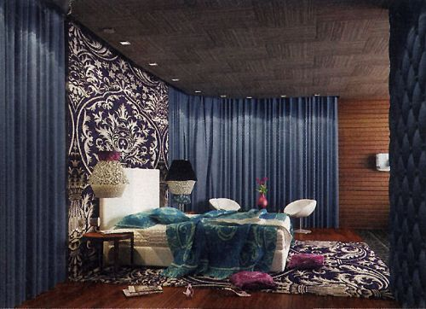
The bedroom

Slide 12
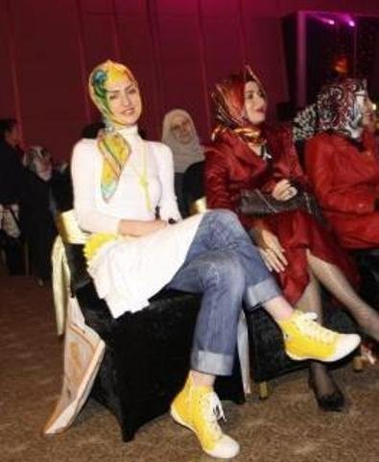
A new type of islamist women

Slide 13
Musiad women play paintball, do bungee jumping
(daily Milliyet, Sept. 10, 2010)

Slide 14
akp
AKP is born from RP. Although equally religious and conservative, its words and deeds are very different: It welcomes foreign capital, engages in privatizations, applies IMF rules
RP’s lesson has served (impact of Kemalism)
Bourgeoisie’s only dictum is: “Maximization of profit” (impact of Globalization)
In foreign policy, AKP is more pro-Western and pro-EU than the Kemalists
In economic policy, AKP now represents the “Calvin-ization” of the Turkish Sunnis
AKP wins the elections of 2002 with a 34 % vote and, with the cooperation of the Grand Bourgeoisie and also the Civil Society, engages in EU Reforms which had already started in 2001
The reform process shows a swapping of roles:
Kemalists are the conservatives: “Catholics”or the «Aristocracy»,
Islamists are the liberals: “Protestants”, or the «Bourgeoisie»,

Slide 15
Despair and Hope
1920s & 30s 2000s
Kemalism EU Reform Packages
⇓ ⇓
⇑ ⇑
Religious Reaction Nationalist Reaction
(“Sèvres Paranoia”)

Slide 16
Dialectics: jacobinism and The islamist party
27 May 1960 Military Coup
1965 elections
(AP victory)
1923
Revolution
First free elections (1950) (DP victory)
June 2011 elections
AKP victory: %50
12 March 1971 Military Coup
July 2007 elections (AKP victory: 47 %) Ergenekon Trials - Military tutelage ends
1974 election victory of civilians
12 September 1980 Military Coup
27 April 2007 Military Memorendum, and Deep State military conspiracies
2002 elections
(AKP victory: 34 %) & “Calvin-ization” of the Islamists
28 February 1997 Military Memorandum
1983 elections (ANAP victory) + 1995 elections (RP victory) & the rise of “Green Capital”

Slide 17
Military action - popular reaction process
This process can best be schematized as follows:
Laicist/Kemalist action
Popular reaction in elections
Stronger popular reaction in elections
More Laicist/Kemalist action

Slide 18
Jacobine action weaker every time
Because:
- One can do “revolution from above” only once…
- And one has no choice but to leave the rest to internal dynamics already triggered by the Revolution from Above
Revolution (1923)
military coup/intervention (1960, 71, 80)
military memorandum
“E-memorandum”
(27 April 2007)
“Post-modern” memorandum (28 February 1997)

Slide 19
Prologue: one question, one answer
Are we heading straight to an “Islamist” tutelage replacing Kemalist Military + Judiciary tutelage? Already alcohol, the best litmus test for Islamic tolerance, has disappeared from AKP-led municipal restaurants and from State ceremonies. Anti-AKP journalists and demonstrating students are detained frequently. Internet is filtered. Erdoğan has just said that Öcalan should have been hanged
No, because this is what Kemalism has taught to them, and we cannot expect them to change overnight. A generational change is needed
On the other hand, the ex-Islamist AKP, in the absence of a meaningful opposition party, must be very closely checked by Civil Society until they become «Muslim-Democrats». Because these ex-Islamists are far from being intrinsically democratic:
Territorially, they come from small towns, strongholds of conservatism all around the World,
Ideologically, they are imbued with religion, and religion is hardly debatable,
Professionally, they come from (also hardly debatable) engineering sciences, in contradistinction with social sciences that are by nature open to discussion and scepticism .

Slide 20
An overall view of the REFORM PROCESS IN TURKEY
Turkish Republic
1st Wave of Mod.
(1920s et 30s)
Turkish Republic
2nd Wave of Mod.
(2001-2004…)
Ottoman Empire
STATE
Memalik-i Şahane
(semi-feudal empire)
Nation-state
(Nat. Security State)
Human Rights State
SOCIETY
The Individual
(civil society)
Umma
Nation
Citizen
(Compulsory)
Citizen
(Voluntary)
PEOPLE
Subject of the Sultan
SUPRA IDENTITY
Turk (Muslim)
(Ethno-religious)
Türkiyeli
(Territorial)
Ottoman (Muslim)

